Slide 1
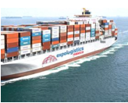
BUSINESS
PROFILE
Executive Brief
built-in logistics for successful exhibitions

Slide 2
OUR GUARANTEE
We offer efficient, fluid & reliable services as well as a rock-solid know-how of all the different resources in logistics and operations required to assure our clients its full satisfaction.
Notes:
2

Slide 3
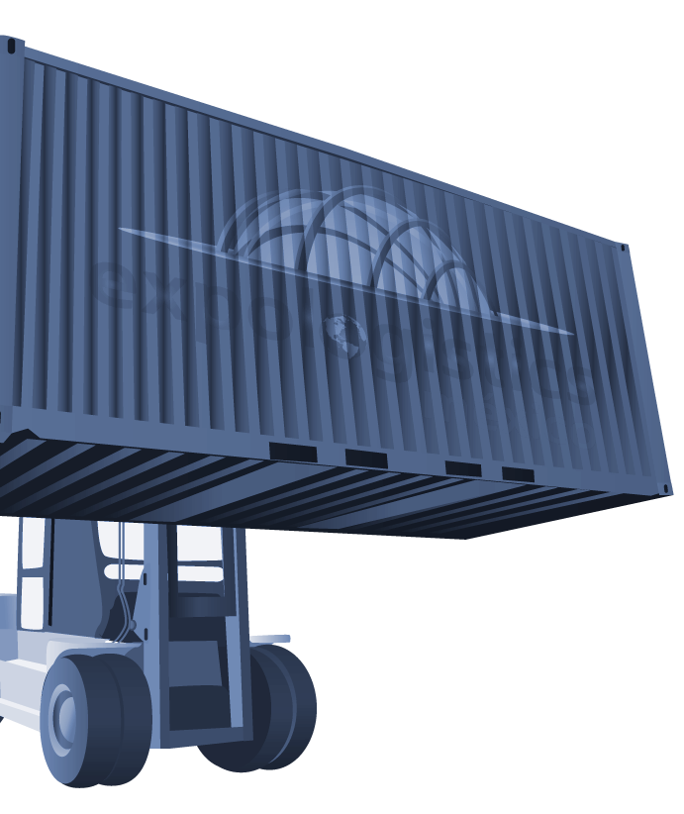
SERVICES
We specialize in:
Built-in logistics planning: We provide you with all the information regarding to packing, pick up arrangements, costs, deadline dates and import / export documentation.
Door to door service: From the collection of your cargo in your facilities by our global agents to the delivery in your booth at the show site.
Efficient & reliable customs clearance: Our agents will make sure that your goods are cleared as quickly as possible; and if you sell your goods at the show site we will take care of the permanent importation process.
Notes:
3

Slide 4
SERVICES
Drayage & delivery: We take care of all the unloading and drayage process of your cargo at the showroom; your goods on time, flawless and ready for the exhibition.
Unpacking & set up: Regardless the nature and size of your cargo, our specialized staff will take care of it; from a forklift to a crane or any other special equipment.
Stand design & building: Whether you require a small or large stand, we will assist you from the design, to the coordination with the show organizer and the construction with the best ideas & materials.
Notes:
4

Slide 5
INTERNATIONAL AGENTS NETWORK
RUSSIA
SWEDEN
ENGLAND
GERMANY
POLAND
FRANCE
SPAIN
ITALY
TURKEY
SOUTH AFRICA
KOREA
CHINA
JAPAN
INDIA
TAIWAN
AUSTRALIA
NEW ZEALAND
CANADA
UNITED STATES
MEXICO
HONDURAS
BELIZE
COSTA RICA
GUATEMALA
PANAMA
EL SALVADOR
VENEZUELA
COLOMBIA
BRAZIL
CHILE
ARGENTINA
Our global network and built-in logistics guarantee our service
in more than 30 countries around the world... and counting.
Notes:
5

Slide 6
SOME OF OUR BUSINESS PARTNERS
UNITED STATES
UNITED STATES
GERMANY
DUBAI
FRANCE
ITALY
UNITED KINGDOM
POLAND
NETHERLANDS
KOREA
COSTA RICA
SPAIN
ARGENTINA
UNISPED LOGISTICS
HONGKONG LTD
TURKEY
HONG KONG
CHINA

Slide 7
2012 - 2015 MAIN EVENTS PARTICIPATION
^{Expo Turquía 2012}
^{Mexico City, Mexico.}
^{Machinery and equipment,}
^{appliances, textiles, food.}
^{* Official Freight Forwarder}
^{Expo ANTAD 2012 - 2015}
^{Guadalajara, Jalisco. Mexico.}
Food, liquors, parfums and toys.
^{* Official Freight Forwarder}
International Book Fair 2012 - 2015
^{Guadalajara, Jalisco. Mexico.}
^{Books.}
^{* Official Freight Forwarder}
^{PLAST IMAGEN 2013 - 2015}
^{Mexico City. Mexico.}
Machinery and equipment for plastic industry.
^{EXPO PACK 2012 - 2015}
^{Mexico City. Mexico.}
Machinery and equipment for packaging industry.
^{ISSA INTERCLEAN 2013}
^{Mexico City. Mexico.}
Machinery and equipment for cleaning industry.
^{Confitexpo 2012 - 2015}
^{Guadalajara, Jalisco. Mexico.}
Confectionery equipment and products, food and candies.
^{* Official Freight Forwarder}
^{International Franchise Fair}
²⁰¹²⁻²⁰¹³
^{Mexico City. Mexico.}
^{Ice creams, milkshakes.}
^{XXVIII Congress of LP Gas}
²⁰¹²
^{Mexico City. Mexico.}
^{Gas cylinders & equipment.}
Notes:
7

Slide 8
2012 - 2015 MAIN EVENTS PARTICIPATION
^{ABASTUR 2012 - 2015}
^{Mexico City, Mexico.}
^{Food, liquors.}
^{* Official Freight Forwarder}
^{EXPO CIHAC 2014}
^{Mexico City. Mexico.}
^{Machinery, equipment and} materials for construction industry.
PAACE Automechanika 2012 - 2015
^{Mexico City. Mexico.}
^{Equipment, materials and spare} ^{parts for automotive industry.}
^{México Alimentaria 2012 - 2013}
^{Mexico City, Mexico.}
^{Food, beverages, liquors.}
^{Mexigrafika 2012}
^{Monterrey, Nuevo Leon. Mexico.}
Graphic arts machinery and equipment.
Espacio Mexican Gift Show 2013 - 2015
^{Mexico City. Mexico.}
^{Lamps, handcrafts, gifts}
Expo Nacional Ferretera 2013 - 2015
^{Guadalajara, Jalisco, Mexico.}
Hardware and construction equipment.
^{EXPO AMPIMM 2014}
^{Mexico City. Mexico.}
Furniture machinery and equipment.
Notes:
8

Slide 9
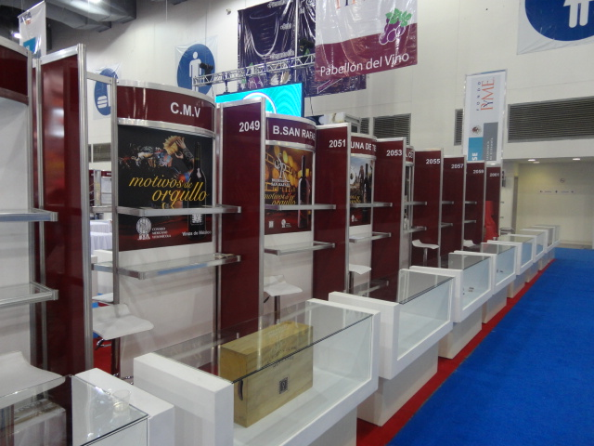
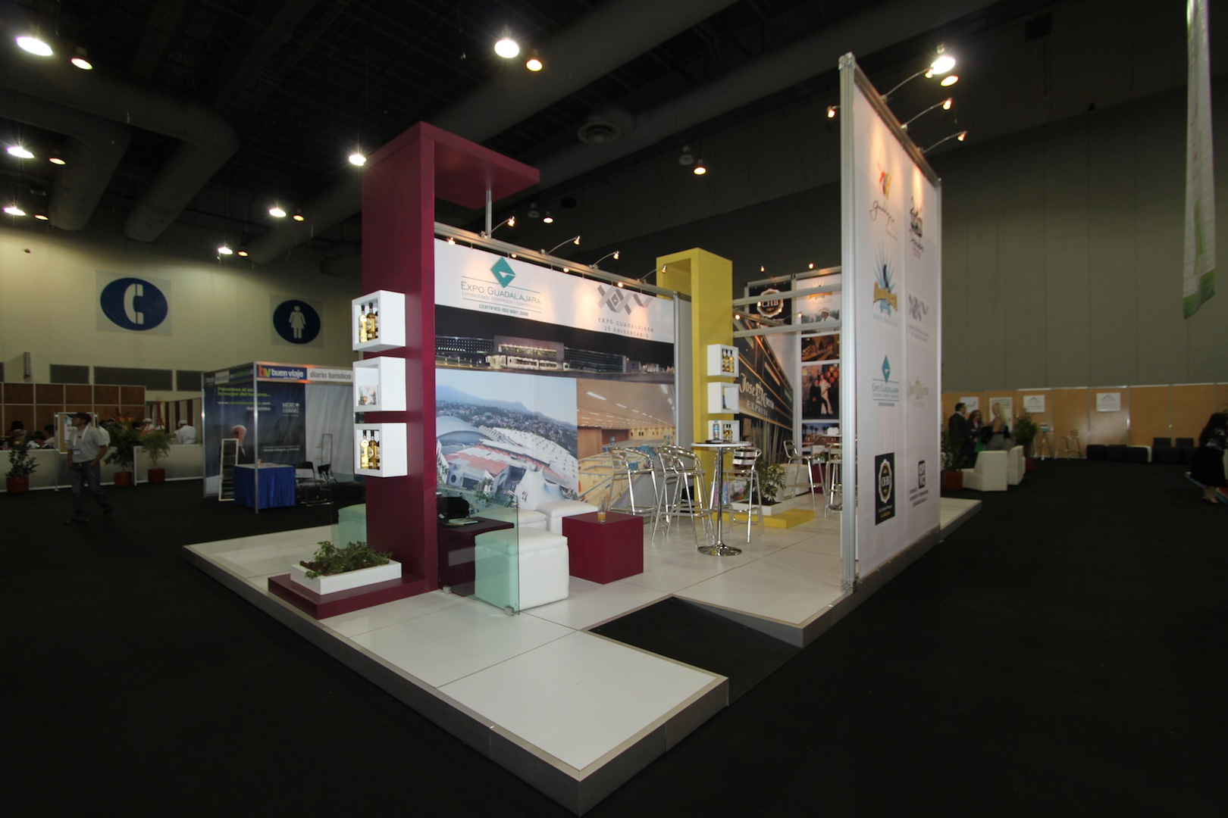
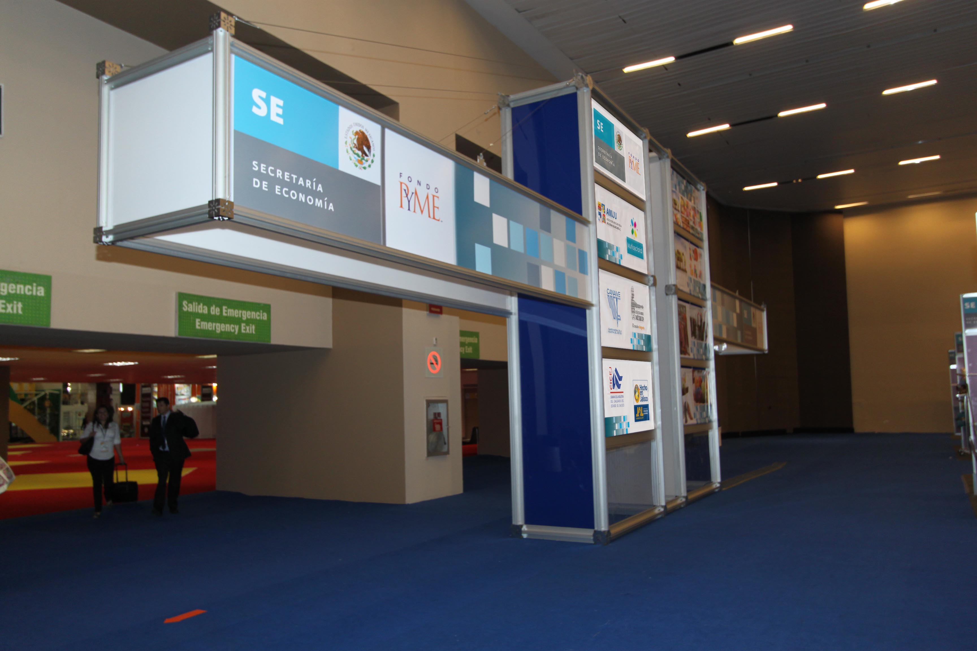
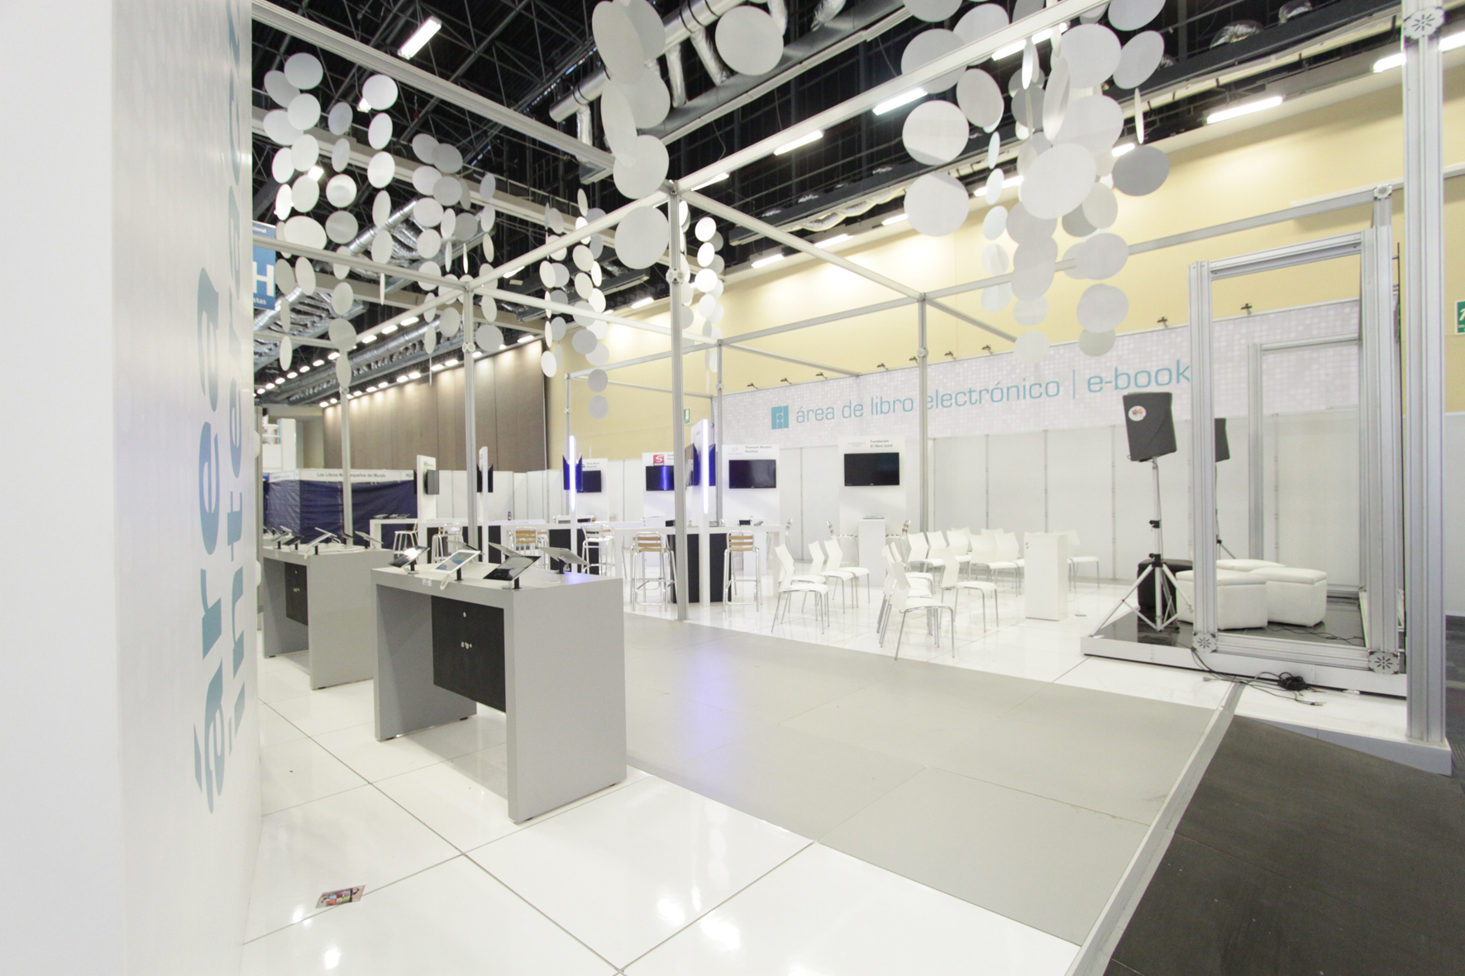
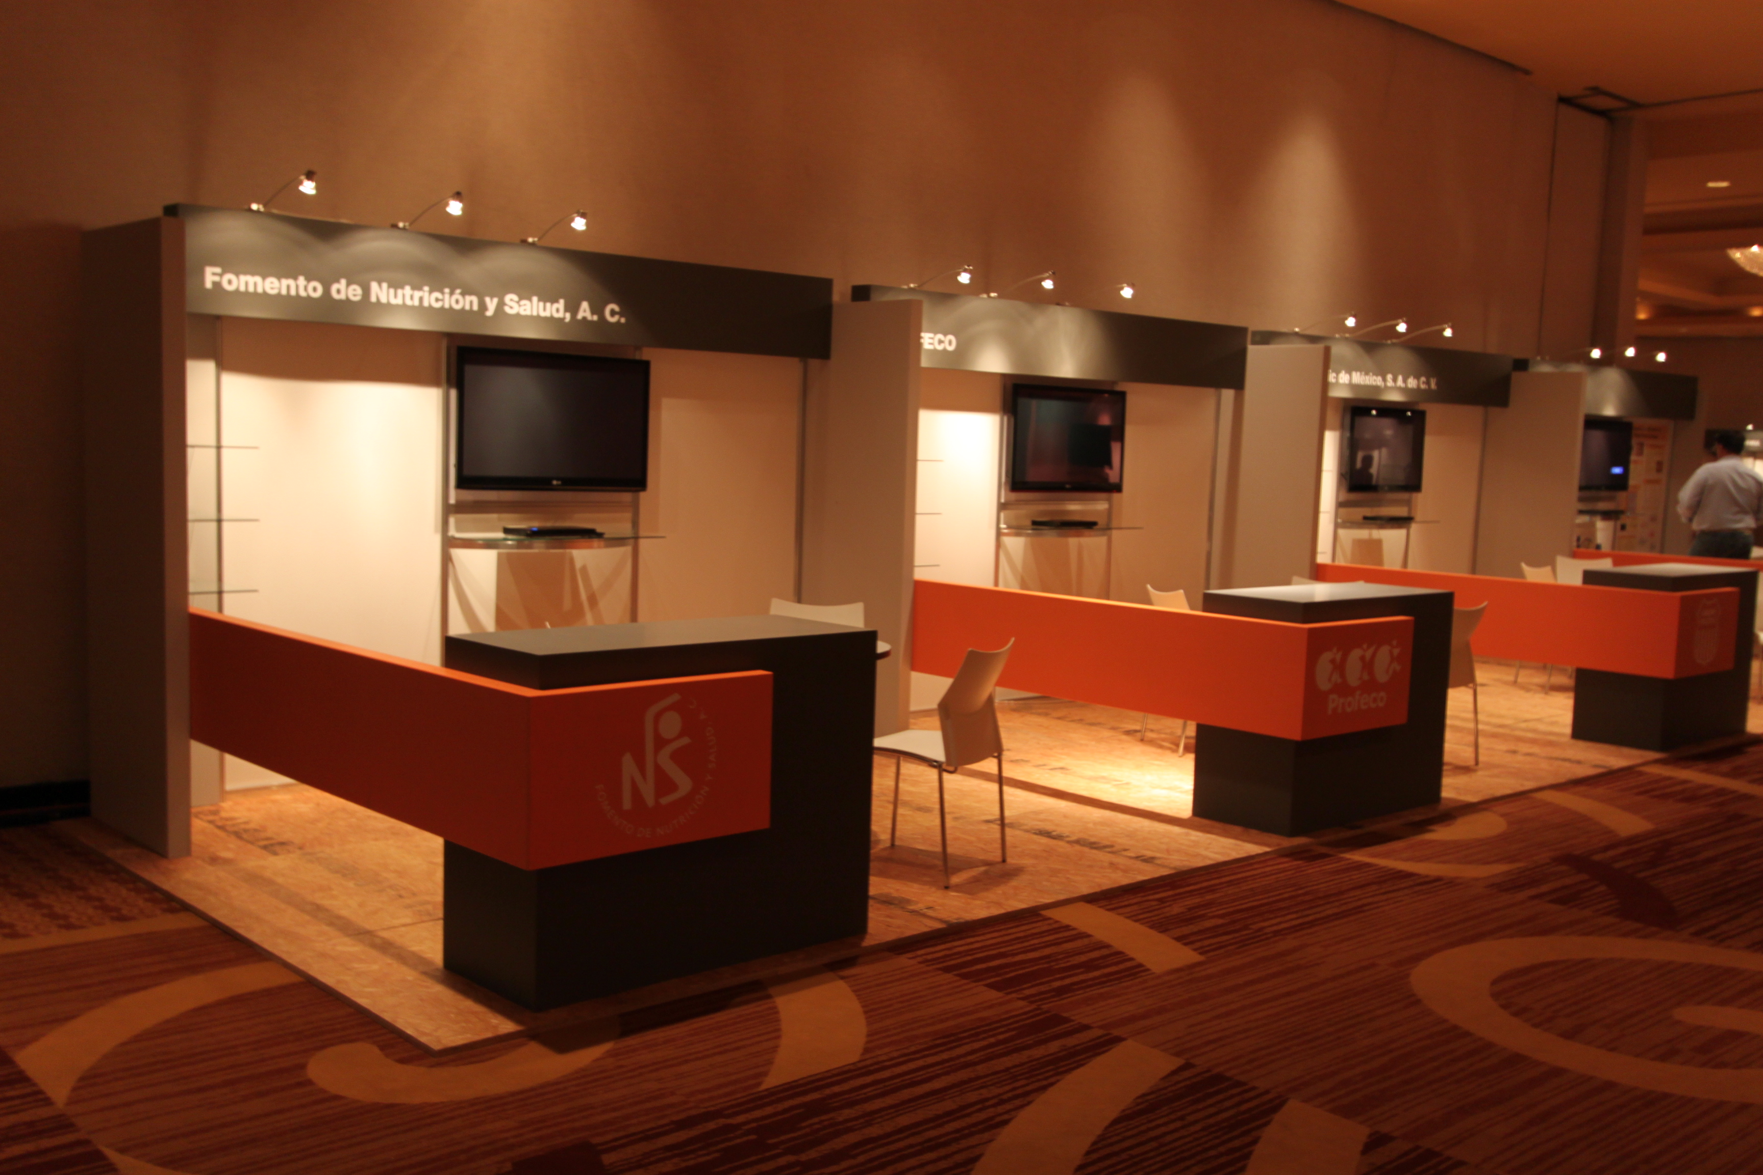
STAND DESIGN & BUILDING
Notes:
9

Slide 10
STAND DESIGN & BUILDING
From the most simple design & materials to a complex customized stand
We will make sure you get the best quality and price
Notes:
10

Slide 11
PASSIONATE ABOUT
TRADE SHOW LOGISTICS
built-in logistics for successful exhibitions
Contact: Miguel Ascencio mascencio@expologisticsmexico.com
Version:1.6.2

